Slide 1

HOSPITAL MANAGMENT SYSTEM

Slide 2
Supervised By
dr \ mohammed atta
dr \ safynaz mohammed

Slide 3


Designed By
Mamdouh marouf abdulrazak
student at fci luxor third level
mahmoud mohammed fouad
student at fci luxor third level

Slide 4
01
Description
our project is a computer system that helps manage the information related to health care and aids in the job completion of health care providers effectively. They manage the data related to all departments of healthcare.
that provides complete facilities for all transactions inside the hospital.

Slide 5





Users That Can use System
System Users
include manager,doctor ,nurse,pharmacy manager,receptionest and accountant.
Users
Doctors
nurses
can view all patients in hospital and there data.
can view all patients.
Manager
pharmacy manager
can modify to any employee in the system add,deleteand search
deal with medicines
receptionest
accountant
deal with patient data from add hem and search patient ets.
deal with employees sallarys and payed them money

Slide 6
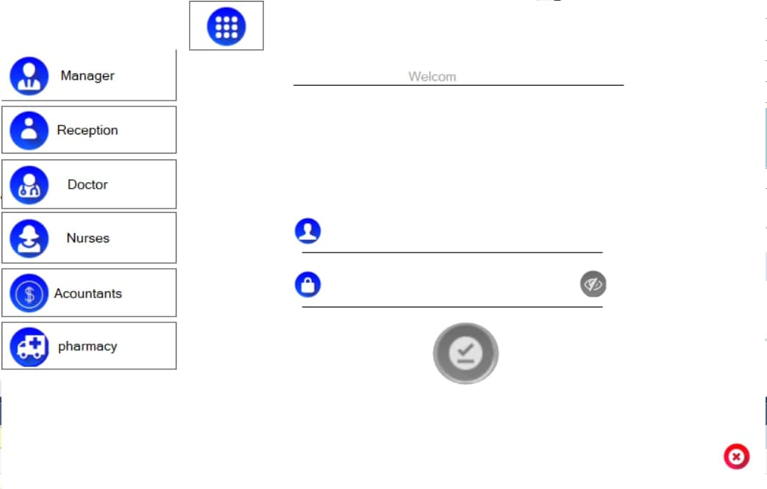
02
login form
this is the form of login that any user of the system should skip it to enter the system.
and he should choise from buttons on the left his jop untill he can insert his ume and password.

Slide 7
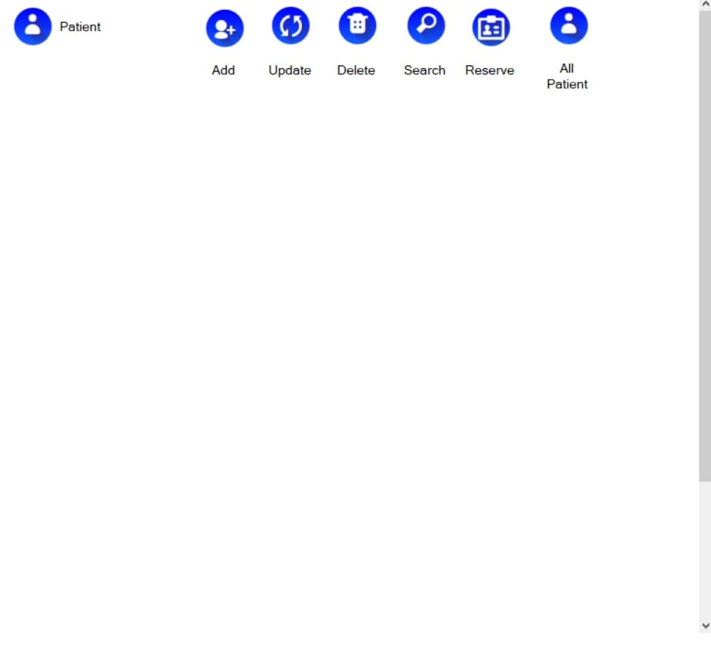
03
reception form
this is the form of reception that from it the receptionest can add a new patient or search and delete any patient from it.
he can view all patients.

Slide 8
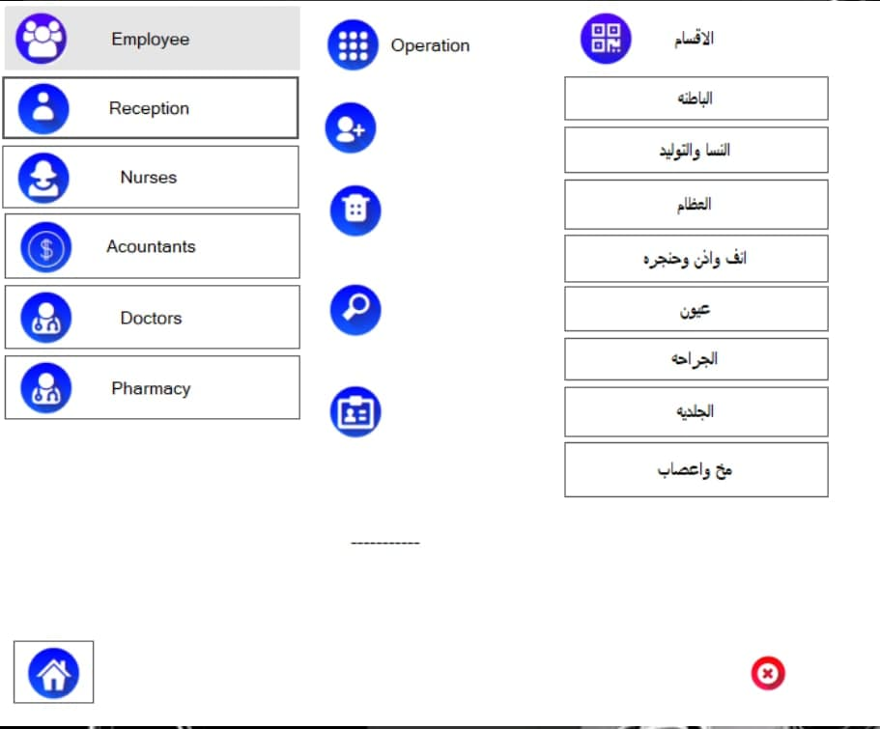
04
Manager form
this is the form of manager that shows after a successful login from manager .
and he can show employess data from any section and any type ,adding a new employee ,delete,search for any employee in the system .
but he is not deal with ant data of patient.

Slide 9
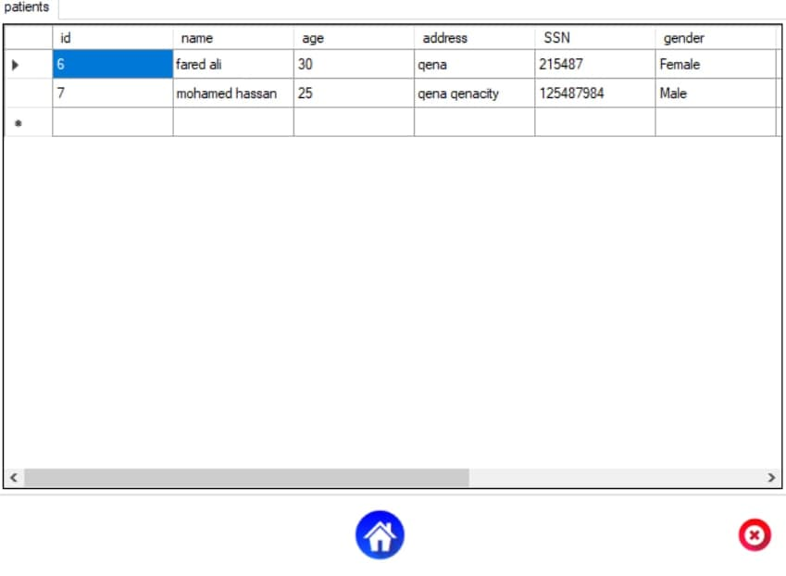
05
Doctor & nurse form
this is the form of doctor and nurse which view all patients and there data.

Slide 10
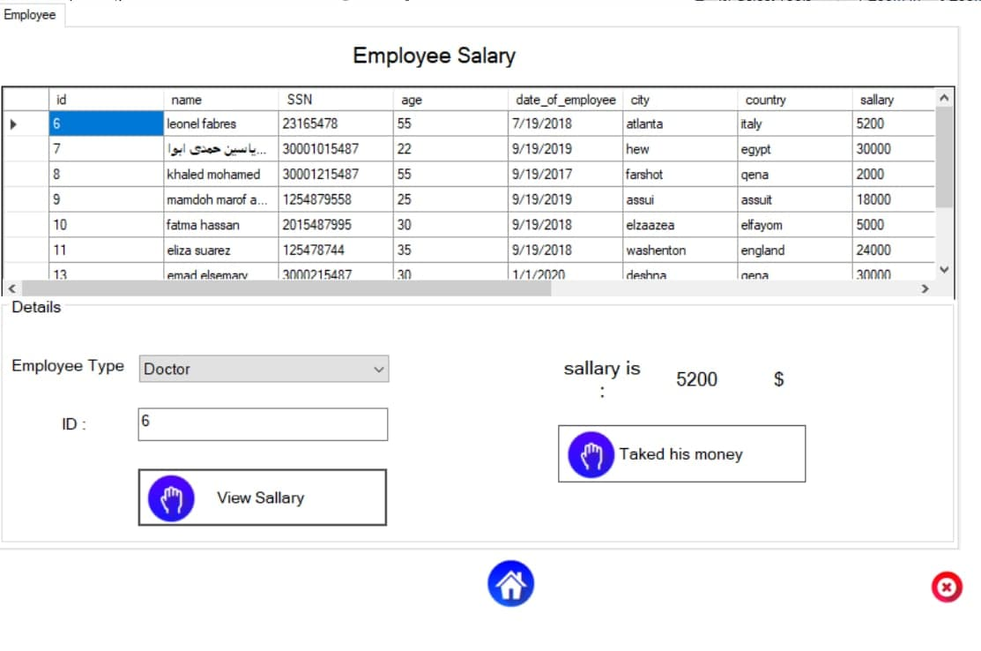
06
Accountant form
this form is view to the accountant after a successful login and views all employess that can get money.

Slide 11
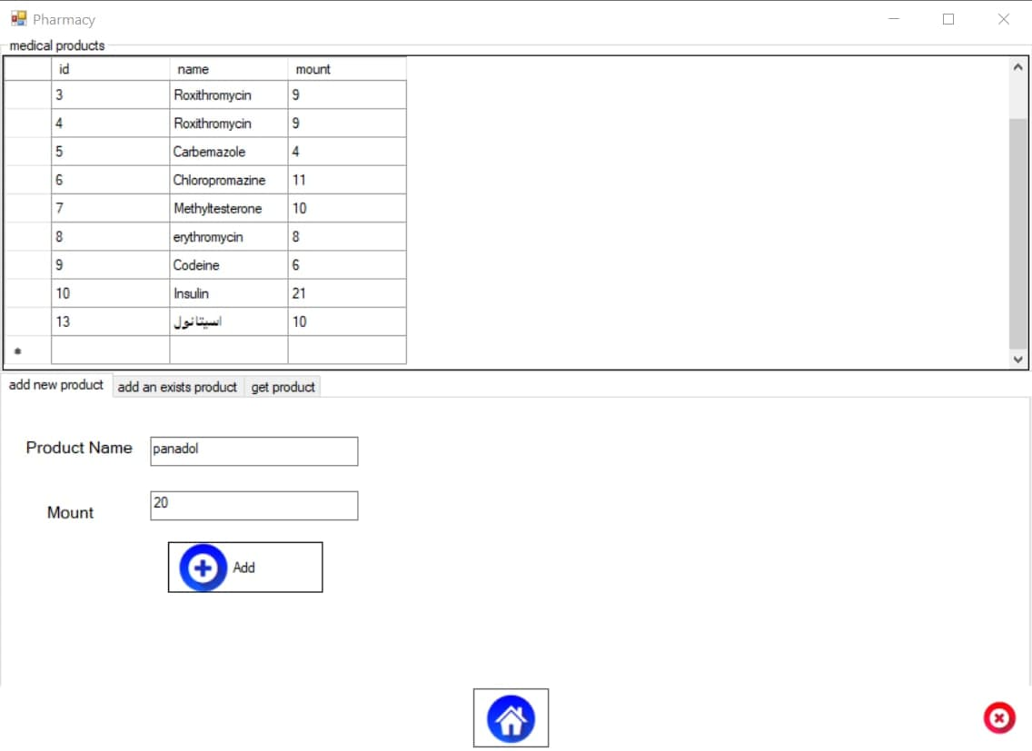
07
Pharmacy form
the form of dealing with midcines from adding a new medical product,add a mount to an exists product and get a mount from a product.

Slide 12
THANK YOU

